Slide 1
Object Oriented Programming :
Inheritance

Slide 2
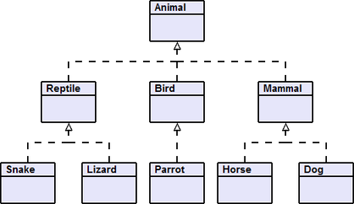
‹#›

Slide 3
Vehicle
-speed: int -direction: double -latitude: double -length: double
+start() +accelerate() : void +brake() : void +SetDirection(direction: double)
Car
-licensePlate : String -fuel: double
+start() +fillUp(fuel: double) : void
Bicycle
-gears : int
+changeGear(gear: int) : void
‹#›

Slide 4
Object
In Java :
We use the extends keyword to inherit from a class
A class can only inherit from one parent
All classes inherit: Object
It is possible to inherit any type of class (even interfaces, regardless if they are abstract or not)
‹#›

Slide 5
Polymorphism
Vehicle
-speed: int -direction: double -latitude: double -length: double
+start() : void +accelerate() : void +brake() : void +SetDirection(direction: double)
Car
-licensePlate : String -fuel: double
+start() : void +fillUp(fuel: double) : void
In an inherited class, it is possible to redefine a method of the parent: this is called polymorphism.
For example, we can imagine that start() in Car will check that fuel is greater than 0 to start the vehicle. In Java, conventionally the @Override annotation is written before the redefined method.
‹#›

Slide 6
Super
In polymorphic classes, it is still possible to call the version of the method defined by the parent: to do this, the super keyword must be used. Example :
super(args...): will call a constructor of the parent
super. methodName(args...) : will call a parent method
‹#›

Slide 7
Overloading (not related to inheritance)
Each method has a unique signature.
Overloading allows you to assign several methods to the same name, provided that the signatures are different; namely that they return different types and/or have different types of arguments.
Example: java.lang.Math.max()
int max(int a, int b) {
return (a >= b) ? a : b;
}
long max(long a, long b) {
return (a >= b) ? a : b;
}
float max(float a, float b) {
...
}
double max(double a, double b) {
...
}
‹#›

Slide 8
Abstract
Abstract class
Vehicle
-speed: int -direction: double -latitude: double -length: double
+accelerate() : void +brake() : void +SetDirection(direction: double)
abstract methods
An abstract class represents an intangible concept, which must be inherited by a concrete implementation. It is not possible to instantiate an abstract class! An abstract method has no body, just a signature. It is up to the inheriting class to determine how it works. The inheriting class must define all abstract methods!
Please note: an abstract class may or may not have abstract methods.
‹#›

Slide 9
Interface
A class can only inherit one other class. But then, how can we use identical behaviours in different classes? An example solution would be to use a Pet interface for both the Cat and Dog classes.
Animal
-age : String
+eat() : void +sleep() : void
<<<Interface>>> Pet
+play() +pet() +feed()
Cat
-life : int
+beAnnoying() : void +beCute() : void
Dog
-happiness: int
+goodDog() : void +badDog() : void
‹#›

Slide 10
Implementation
An interface is a contract: It defines mandatory behaviours for the class that implements that interface. By definition, an interface can only contains abstract methods. In Java :
We use the implements keyword to implement an interface
It is possible to implement several interfaces for one class
An interface can inherit one or more other interfaces
Although an interface contains only abstract methods, the abstract keyword should never actually be used in the interface or the methods.
It is possible for the methods of an interface to have a body. This will determine its default behaviour.
‹#›

Slide 11
Concrete example
<<<Interface>>> Collection
The List interface inherits from the Collection interface. Because of its polymorphism, List extends the Collection interface and adds in its own methods, for example:
get(int position)
indexOf(Object o)
However, List is still only an interface (a contract) and it is not possible to instantiate it. ArrayList implements List, and has the role of determining how all the methods in:
List and
Collection, (because List inherits from it)
should work.
extends
<<<Interface>>> List
implements
ArrayList
‹#›

Slide 12
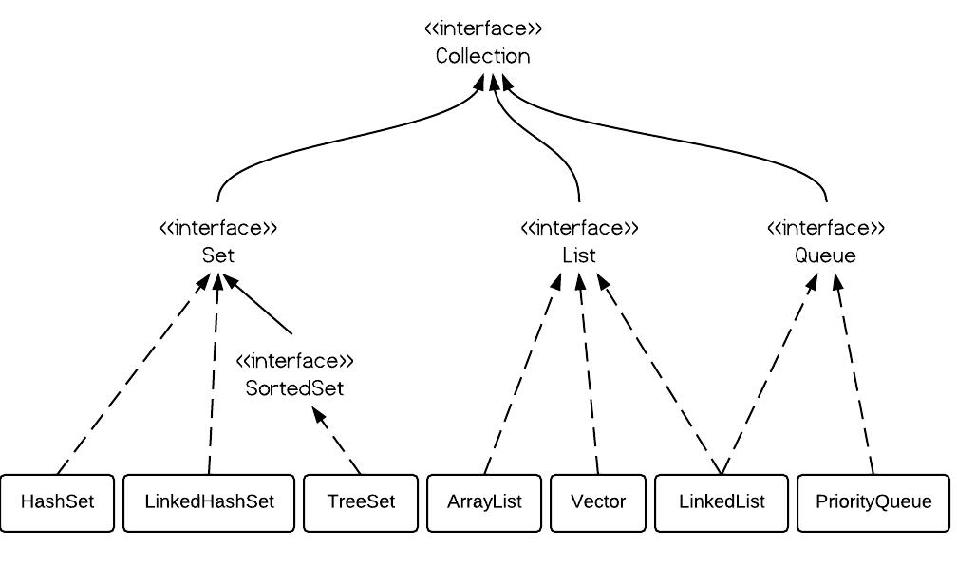
Concrete example
DZone: ArrayList vs. LinkedList vs. Vector
‹#›

Slide 13
UML
UML diagram : Graphical representation of the object-oriented programming
+ : Public
- Private: Private
# : Protected
~ : Package
underline : static
italic : abstract
ALL-CAPS: constant
The inheritance is represented by : The implementation is represented by :
Car
-licensePlate : String -fountain: double
+start() +fillUp(fuel: double) : void
<<<Interface>>> MusicPlayer
+play() +stop()
Vehicle
-speed: int #VEHICLE_TYPE : String
+start() +accelerate() : void +brake() : void +getType() : String
‹#›

